Slide 1
Ghana Case Study
September 2026

Slide 2
Say hello and thank you to our amazing team

Slide 3
GHANA CASE STUDY
What this presentation covers
1
Introduction
4
Gender inclusion
2
Localisation and structural transformation
5
Factors or actors preventing or supporting localisation, decent work and gender inclusion in Ghana's solar PV sector
3
Decent work
6
Conclusion

Slide 4
1. Introduction

Slide 5


1. INTRODUCTION · THE MARKET
A booming market, a thin local share
2.4%
39%+
80–90%
220k–400k
Grid installed solar capacity by end-2025
Projected C&I solar market CAGR through 2031
Local participation target for solar PV manufacturing by 2025
Projected renewable-energy jobs
Target vs reality: an 80–90% local participation target, yet local production of cells, modules and inverters remains minimal.
The situation
Ghana’s solar market is expanding, but domestic participation remains concentrated in importing, distribution, installation and maintenance.
What the study asks
How can market potential be translated into domestic industrial capability, stable employment and broader participation by all genders?
Notes:
completed report, experience of completing report and what it illuminates ito of findings….evaluation of uptake, once it has been launched.generating report, what it illuminates, implications and outcomes….how they want to use it..or should be used to generate impact. the process, findings, outcomes, planning for impact

Slide 6




1. INTRODUCTION · METHODOLOGY
How we studied Ghana’s solar sector
Mixed methods
Component selection: nexus of
Theoretical approach
Analytical dimensions
Quantitative firm survey
Import value
Global Production Network
(GPN)
Localisation
Qualitative stakeholder interviews
Labour intensity
Decent work
Comprehensive desk research
Life cycle
Gender inclusion
Existing local manufacturing capacity
SMME integration

Slide 7
2. Localisation and structural transformation

Slide 8
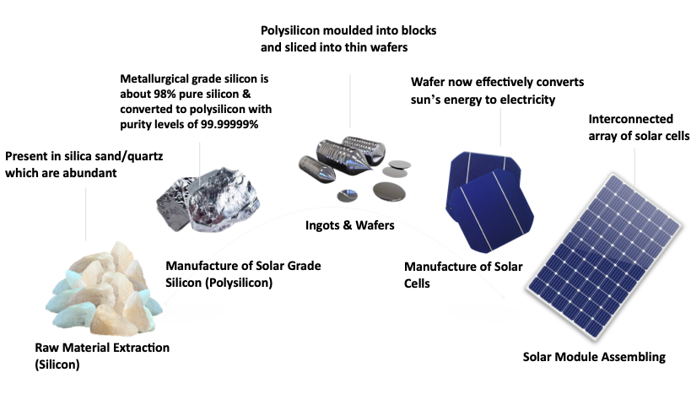
Solar PV Value Chain Vs Production Network
The value chain captures one aspect of the picture

Slide 9
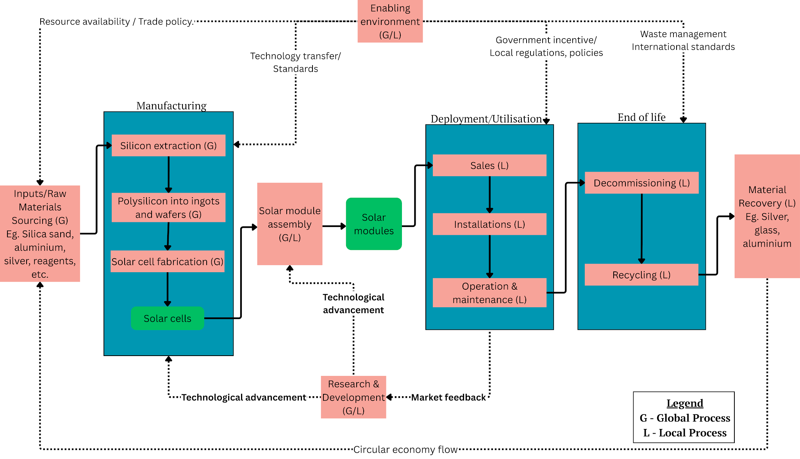
Solar PV Value Chain Vs Production Network
Production network reveals the wider relationships and support systems behind production
Potential for localization lies here

Slide 10
2. LOCALISATION
Installed here, made elsewhere
MADE ELSEWHERE
WHERE GHANA’S FIRMS ARE CONCENTRATED
EMERGING
Cells & modules
Inverters & batteries
Import & distribution
Retail
Installation
Operation & maintenance
End-of-life & recycling
▲ Ghana is here
Upstream
Local production of cells, modules and inverters remains minimal.
Downstream
Ghana’s participation is concentrated in installation, distribution, retail and maintenance.
Next step
Nascent assembly indicates that movement into higher stages of the supply chain is possible, but requires deliberate industrial support.
Notes:
completed report, experience of completing report and what it illuminates ito of findings….evaluation of uptake, once it has been launched.generating report, what it illuminates, implications and outcomes….how they want to use it..or should be used to generate impact. the process, findings, outcomes, planning for impact

Slide 11


2. LOCALISATION · TRADE
Imports doubled in five years
Solar PV imports, US$ million
What leaves with the value
US$15.9m
Productive capabilities
LIMITED
Technology ownership
US$7.8m
LIMITED
Higher-value employment
LIMITED
2018
2023
The sector’s current position limits opportunities to build productive capabilities, technology ownership and higher-value employment.
This illustrates the scale of value leaving the domestic economy.

Slide 12








2. STRUCTURAL TRANSFORMATION
Quick wins now, upgrading over time
Near-term opportunities
What enables structural upgrading
More consistent implementation of local-content policy
Certification, quality systems and production capabilities
Local assembly of solar modules
Mounting frames, cables and packaging
Skills beyond basic installation
Predictable demand through government procurement
Long-term operations and maintenance services
Panel recycling and end-of-life services
Manufacturing-grade finance at appropriate tenures
Notes:
completed report, experience of completing report and what it illuminates ito of findings….evaluation of uptake, once it has been launched.generating report, what it illuminates, implications and outcomes….how they want to use it..or should be used to generate impact. the process, findings, outcomes, planning for impact

Slide 13

Localisation and structural transformation
Expansion not kept pace with shift in domestic production
Downstream concentration
  installation, retail, distribution, and basic operations and maintenance
Localisation not entirely absent
  Attempts at solar PV assembly
  Demonstration of technical feasibiltiy
  Challenges the lack of productive capacity narrative
Emerging localisation, but fragile

Slide 14
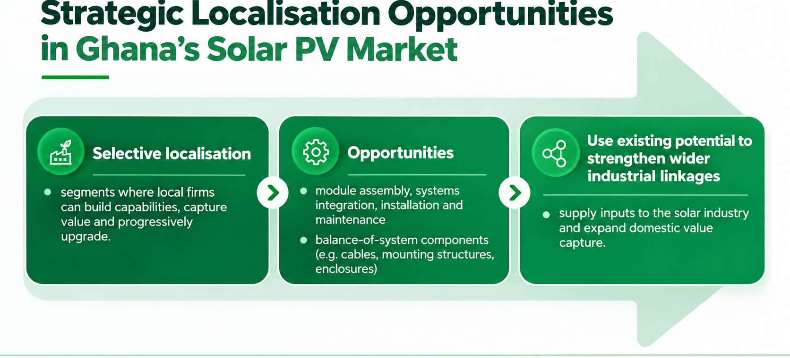
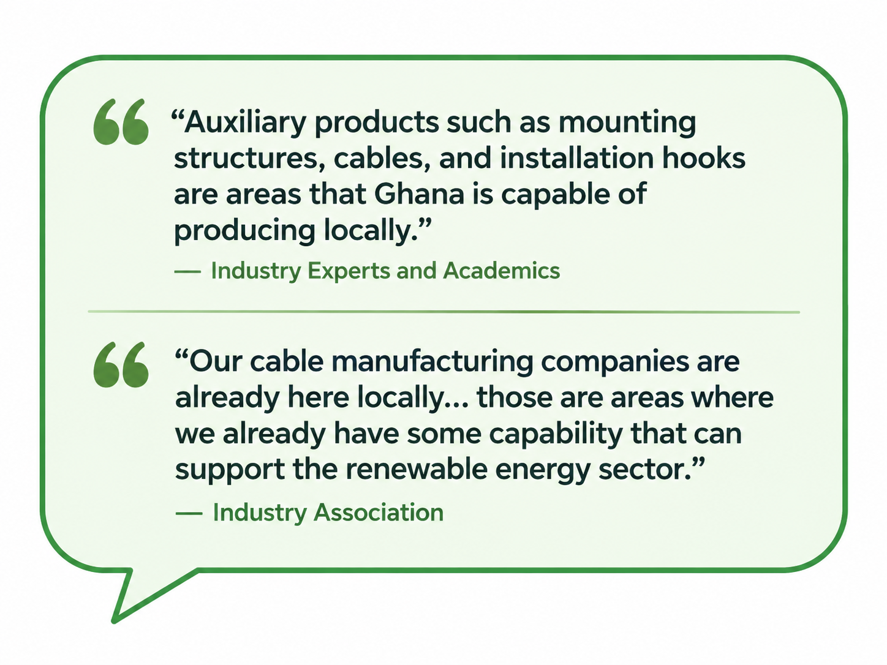

Slide 15
3. Decent Work

Slide 16
3. DECENT WORK
Jobs that end when the project ends
STEP 3
STEP 4
Downstream structure
Project-based contracts
Short-term jobs
Little protection
Work is organised through ad hoc, project-based contracts.
Survey evidence shows solar employment is predominantly short-term and project-based.
The sector is concentrated in installation activity rather than production.
Workers have limited access to formal labour protections or social security.
Way forward: Building local manufacturing and higher-value services can broaden the range and durability of employment opportunities.
Notes:
completed report, experience of completing report and what it illuminates ito of findings….evaluation of uptake, once it has been launched.generating report, what it illuminates, implications and outcomes….how they want to use it..or should be used to generate impact. the process, findings, outcomes, planning for impact

Slide 17
Employment in the solar sector
Jobs are concentrated in downstream activities
  dominated by installation, after-sales servicing, engineering, procurement and maintenance.
  installation workers on mainly engaged on project-by-project basis.
  Firms retain a small permanent core
Job quality is shaped by skills and professionalisation
  specialised workers tend to have better prospects for repeated contracts and progression.
Demand uncertainty affects employment stability
Informality and weak licensing or certification
  make labour and technical standards harder to enforce.

Slide 18
4. Gender Inclusion

Slide 19


4. GENDER INCLUSION
21%
Women’s share of energy-sector employment in Ghana
3.4×
More unpaid work performed by women than men
13%
Surveyed firms with a formal gender policy
Unpaid work
Men
Women
Male-dominated recruitment networks narrow entry pathways
Training has not systematically opened pathways for women
Thin margins limit gender initiatives beyond donor-funded projects
Notes:
completed report, experience of completing report and what it illuminates ito of findings….evaluation of uptake, once it has been launched.generating report, what it illuminates, implications and outcomes….how they want to use it..or should be used to generate impact. the process, findings, outcomes, planning for impact

Slide 20




4. GENDER INCLUSION
From barriers to entry points
Current constraints
Potential entry points
Project-based work can require mobility and irregular hours
Create more stable technical and manufacturing roles
Field roles are often culturally coded as male
Broaden technical and vocational pathways
Recruitment relies heavily on informal professional networks
Embed gender requirements in licences and contracts
Gender programmes are often donor-dependent
Make gender inclusion part of sector performance rather than standalone projects
Notes:
completed report, experience of completing report and what it illuminates ito of findings….evaluation of uptake, once it has been launched.generating report, what it illuminates, implications and outcomes….how they want to use it..or should be used to generate impact. the process, findings, outcomes, planning for impact

Slide 21
Gender equality in Ghana’s clean energy transition
Women’s participation remains segmented
  Participation in technical roles remains limited
Inclusion is about more than participation numbers
  gender equity also depends on working conditions (e.g. maternity protection
Policy commitments are not yet matched by strong implementation mechanisms
  Gender is increasingly recognised in policy but yet to see strict enforcement
  Gender-responsive interventions are often project-based or donor-driven, making progress uneven and difficult to sustain.
The central issue is how opportunities and burdens are distributed
  The transition can create new economic opportunities for women,
  but it can also reproduce existing inequalities

Slide 22
5. Factors or actors preventing or supporting localisation, decent work and gender inclusion in Ghana's solar PV sector

Slide 23



6. CONCLUSION
Seven challenges stand in the way
Cost competitiveness
Policy implementation gap
Financing misalignment
Absence of technology transfer obligations
Decent work deficit
Skills and workforce development deficit
Low participation of women

Slide 24

5. KEY ACTORS
Who has leverage over change
Government / Ministry of Energy
industrial and local-content policy
Development partners
catalytic finance and capacity support
Energy-sector regulators
licensing, standards and compliance
Localisation, decent work & gender inclusion
Industry associations
strengthen firm relationships
Financial institutions
financing terms and risk assessment
Labour and civil society
decent-work and accountability functions
Solar firms
upgrading, recruitment and workplace practices

Slide 25
6. Conclusion

Slide 26
6. CONCLUSION
Six opportunities to act on
Local module assembly and BOS component manufacturing
Public procurement as an industrial policy instrument
Long-term operations and maintenance services
Solar PV recycling and AfCFTA regional market access
Technology transfer as a condition of market access
Gender-targeted procurement and training

Slide 27
6. CONCLUSION · THE BOTTOM LINE
Growth alone is not enough
The market is growing fast, but Ghana’s firms mostly import, distribute, install and maintain, while cells, modules and inverters are made elsewhere.
1
Short-term, project-based work and the low participation of women limit who benefits from the transition.
2
Finance, public procurement, skills, certification and consistent local-content policy can move Ghana up the value chain.
3

Slide 28
Thank You!

