Slide 1
Using Policy to Build South Africa’s Renewable Energy Industry and Create Decent, Equitable Jobs
Making Africa’s Energy Transition Work
08-09 October 2026

Slide 2
CONTENT
1. Current Content - What South Africa’s RE Manufacturing Sector looks like
2. Methodology
3. Challenges & Opportunities for Developing RE Manufacturing in South Africa
  Looking into the market, productive capabilities, institutions, governance, inclusion and decent work.
4. Towards Developing Inclusive Localised RE Manufacturing in South Africa
5. Annex

Slide 3
“Q: Are you able to weld like the men who weld?
R: No, the welding isn’t the same. . . .I can’t weld the type of work he does.
Q: Why can’t you do the other type?
R: It is very complicated. It’s so difficult that I don’t think there is a woman who can work in that department. She may try, but I don’t think she would last long there.” (Discussion with Female Solar Industry Worker)
“The Chinese make things on a scale that I don't think we can fully wrap our head around . . . They can mass manufacture modules, cables, mounting structures, inverters. The whole value chain they make at the scale that dwarfs everybody else.” (Solar Industry Manager)
“There were 6,000 people sitting outside our facility looking for work... and we could only employ about two to three hundred people... which was only a short-term contract as well.” (Solar Industry Manager)
“R: I live with my aunt and my siblings. . . We are seven. . . Some are children though — two are still small. We’re actually five.
Q: Who is the breadwinner?
R: It’s my younger aunt.
Q: Okay, okay. She’s the one who provides most things?
R: Yes.” (Discussion with a Male Solar Industry Worker)
“The government changed the rules… you no longer need local content… So, we closed the factory… and retrenched everyone.” (Wind Industry Manager)

Slide 4
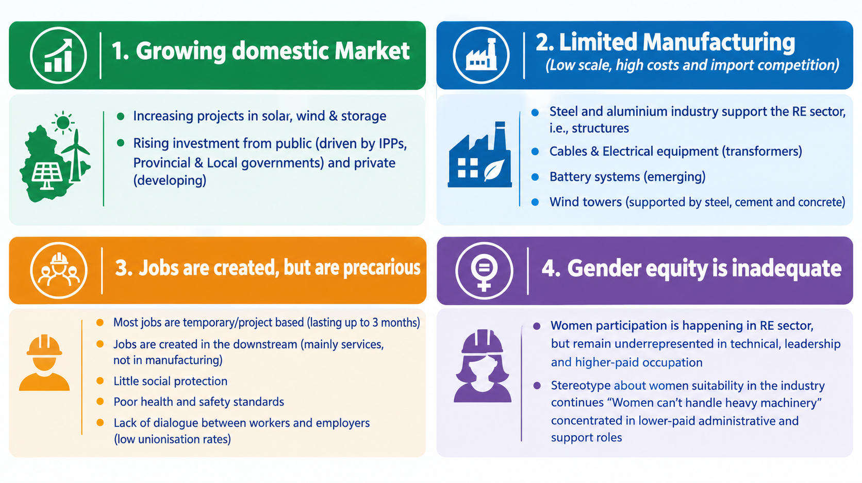
WHAT THE RE SECTOR LOOKS LIKE IN SA TODAY

Slide 5
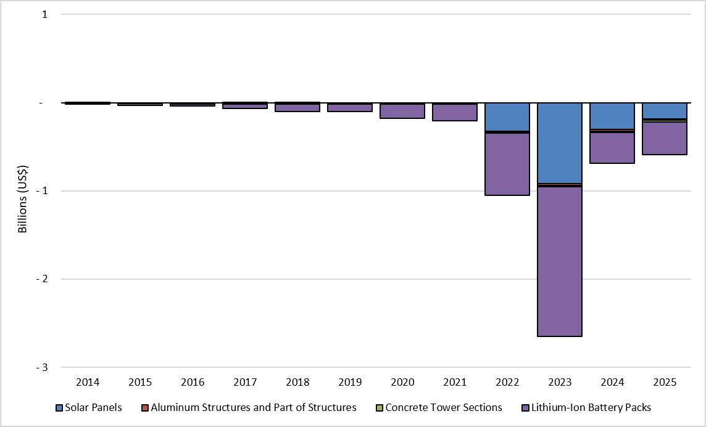
WHAT THE RE SECTOR LOOKS LIKE IN SA TODAY
Trade Balance of Selected Renewable Energy products (2014-2025)
5. High import dependence
Majority of solar PV modules are imported
Wind turbines and key components largely imported
BESS mostly imported
Inverters, trackers, cables and other critical imports are imported
Source: Data calculated from UN Comtrade (2026)

Slide 6
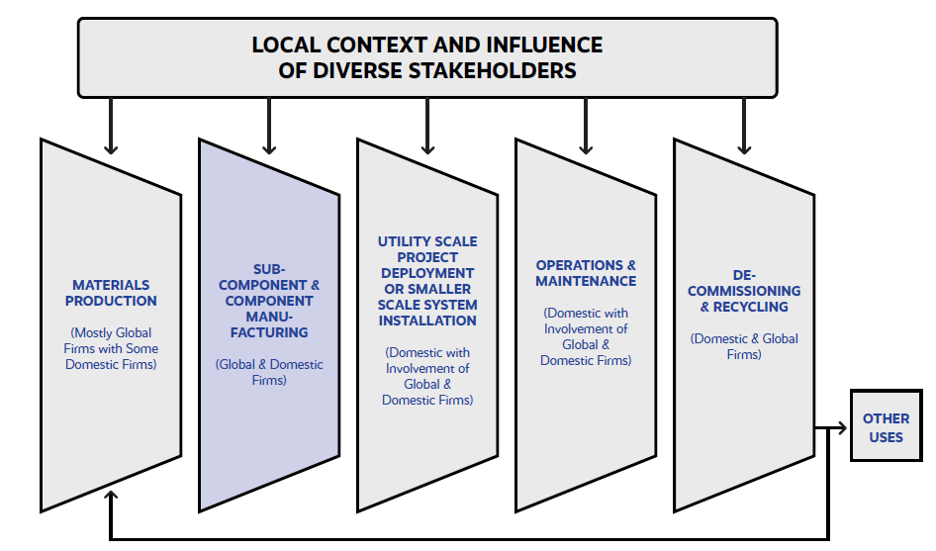
WHAT THE RE SECTOR LOOKS LIKE IN SA
Global Firms control most of the domestic renewable energy production networks – But there is a presence of domestic value creation and capture which could be enhanced.
Sourced from a Detailed Case Study from the localising the Just Energy Transition project

Slide 7
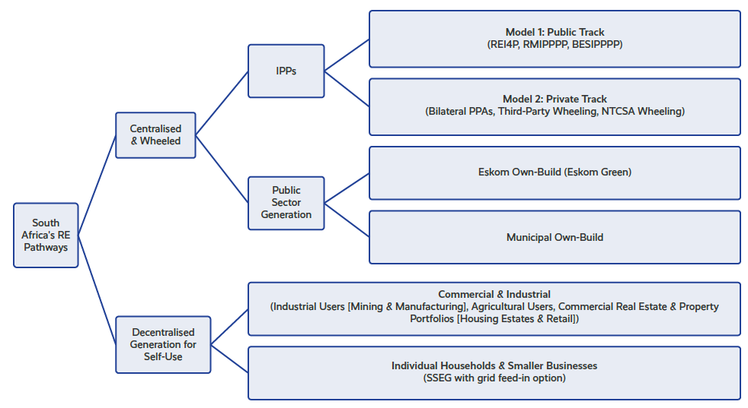
WHAT RE SECTOR LOOKS LIKE IN SA
RE system includes centralised and decentralised branches.
The centralised branch has both public and private driven supply chains.
Sourced from a Detailed Case Study from the localising the Just Energy Transition project

Slide 8
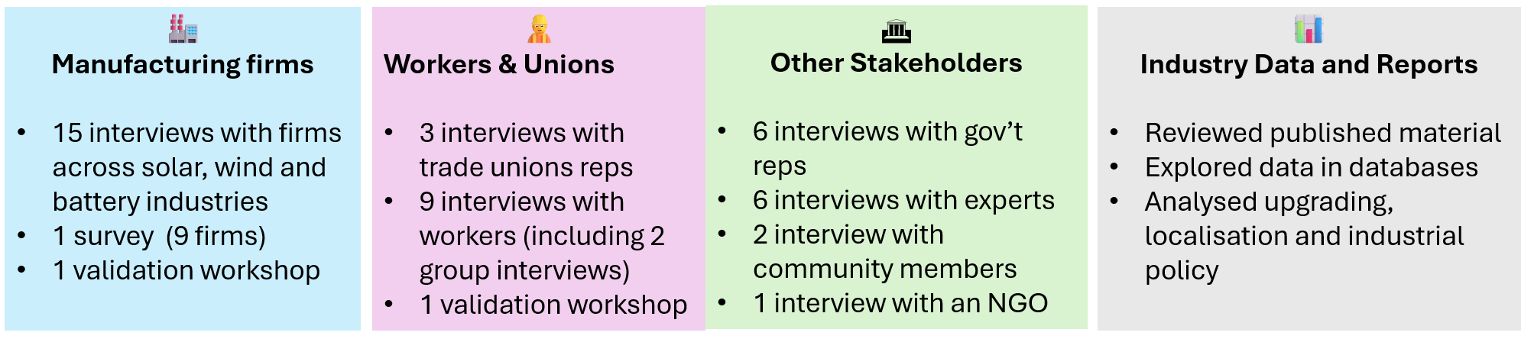
METHODOLOGY

Slide 9
MARKET DYNAMICS:

Slide 10
MARKET DYNAMICS
CHALLENGES
  Price competition from cheaper imports - Expensive to produce RE products in SA than in China
  Stop-Start’ Demand Cycles from Public Procurement – erratic tender windows (Stop-start of Bid Windows)
  Global Project Implementers Rely on Existing Suppliers Leaving Limited Opportunities for SA Manufacturers – Capture of Domestic Production network by global firms
  OPPORTUNITIES
  Attracting Global Technology Transfers & FDI – Especially in cell manufacturing which SA does not have
  Leveraging the Surging Private Track and Decentralized Markets – Removed NERSA licensing caps provide a new window of opportunities for increasing demand (We need to be careful of international infiltration)
  Growing Eskom Green & Other Public RE Projects (e.g., municipal) – Enact Local Sourcing Preferences

Slide 11
Institutions and Governance:

Slide 12
INSTITUTIONS & GOVERNANCE
CHALLENGES - Policy Design, Inconsistency, and Institutional Alignment Gaps
  Watering Down of Local Content Policies – Local content requirements are evaded –one way this is done is through the continuous approval of porous post-bid exemptions
  Erratic Policy Implementation – Delays in policies, Energy Roadmaps, SAREM etc
  Lack of Government Policy Coordination & Regulatory Clarity – who is responsible for Industrial Policy?Is the dtic or National Treasury
  Trade and Tariff Misalignment – issues of stages consignment
  CHALLENGES - Technical Infrastructure, Capabilities, and Data Systems
  Weak Standards, Testing, and Certification Systems – allowing low-standard RE products
  Data Quality Challenges –Jobs are not adequately measured

Slide 13
INSTITUTIONS & GOVERNANCE
CHALLENGES - Asymmetric Policy Influence
  Concentration of LCR Benefits– monopolising of public contracts
  Liberalisation of Energy Markets– Market liberalisation traps workers in temporary, non-unionised installation roles (by bypassing transformation policies such as B-BBEE etc).
  Corporate Capture & Exclusion of Small & Medium Enterprises– SMEs are excluded from policy dialogues
  CHALLENGES - Regulatory Evasion & Systemic Abuse
  Corruption – Customs fraud, corporate fronting, & active extortion
  Evasion of Local Content Policies –circumvention of localisation scorecards
CHALLENGES - Other
  Foreign State Subsidisation of Homegrown Enterprises

Slide 14
INSTITUTIONS & GOVERNANCE
  OPPORTUNITIES
  Building Regional Connections – Regional Manufacturing hub – utilising AfCFTA
  Establishing Collaborative Production Alliances and Small-Firm Joint Bidding – SMEs coming together to access RE opportunities
  Improving Government’s Responsiveness to Market Conditions – Regular policy updates

Slide 15
Domestic Productive Capabilities:

Slide 16
DOMESTIC PRODUCTIVE CAPABILITIES
CHALLENGES
  Skill Shortages:
uncoordinated TVET initiatives suffer from weak industry alignment, producing certified graduates who struggle to secure good jobs
Postgraduates & senior engineering professionals migrate abroad due to prolonged domestic market instability
  Limited Capacities of Firms:
Limited financial capital to support scale
Gaps in the value chain - e.g., South Africa does not produce solar or battery cells
  OPPORTUNITIES – Develop Entire Production network (Considering Comparative advantage)
  Capitalising on Low-Risk SME Subcomponent Spin-offs – Development of Tier 2 & 3 suppliers
  Establishing Core Midstream Manufacturing Capabilities – Focus on manufacturing (a step by step approach)
  Upgrading Domestic Mineral Beneficiation Capabilities – Upstream development
  Scaling up Services – Develop after market services
  Expanding Recycling Capabilities – Especially in battery materials

Slide 17
Inclusion and Decent Work:

Slide 18
INCLUSION & DECENT WORK
CHALLENGES
  Unequal Benefits of Transition:
Restrictions for SMME to participate in local value creation
Long term structural unemployment – coal workers losing their jobs
  Gender Stereotypes and Occupational Segregation – shape recruitment, training, & career progression across the RE sector
  Unequal Social Reproduction Burdens - Women continue to shoulder a disproportionate share of unpaid care work & household responsibilities, limiting their access to training, employment, & career advancement
  Limited Trade Union Representation – mainly because of precarity in jobs created
  OPPORTUNITIES
  Generating Increased Numbers of Good Jobs in Renewable Energy Production Systems – The high labour intensity of specific manufacturing segments — such as solar tracker systems and BoP hardware
  Expanding Worker, Social, & True Community Ownership Models – social models can transform communities & build relationships between industry, government & communities
  Expanding Rural Mini-Grids for Localised Community Livelihoods – for those far from the central transmission lines (electrification)

Slide 19
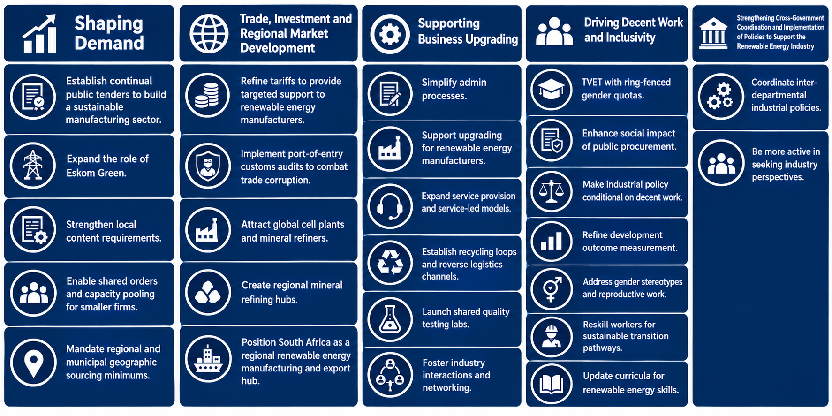
TOWARDS DEVELOPING AN INCLUSIVE LOCALISED RE MANUFACTURING IN SOUTH AFRICA
Strengthen Government Effectiveness
Sourced from a Detailed Case Study from the localising the Just Energy Transition project

Slide 20
Shaping Demand
  1. Establish Continual Public Tenders to Build a Sustainable Manufacturing Sector – Sustainable-multi-year procurement
  2. Expand the Role of Eskom Green – As an anchor customer for RE
  3. Strengthen the Design, Implementation, and Enforcement of Local Content Requirements - firmly institutionalise and standardise the component-specific minimum thresholds introduced in recent bidding rounds to eliminate developer circumvention
  4. Enable Shared Orders and Capacity Pooling for Smaller Firms - public IPP Office should issue single, multi-gigawatt, bankable anchor contracts
  5. Mandate Regional and Municipal Geographic Sourcing Minimums - Allow municipalities and provincial governments to incorporate local geographic sourcing requirements into RE procurement where appropriate

Slide 21
Trade, Investment and Regional Market Development
  1. Refine Tariff System to Provide Targeted Support to Renewable Energy Manufacturers - Updating the national tariff architecture insulates infant RE industries from predatory foreign pricing structures
  2. Implement Port-of-Entry Customs Audits to Combat Trade Corruption - Deploying targeted SARS and ITAC inspectors to ports of entry to deal with stage consignment
  3. Attract Global Cell Plants and Mineral Refiners – InvestSA offers incentives for global cell manufacturer
  4. Create Regional Mineral Refining Hubs to Secure Supply Autonomy – utilise AfCFTA regional integration
  5. Position South Africa as a Regional Renewable Energy Manufacturing and Export Hub - utilise AfCFTA regional integration

Slide 22
Supporting Business Upgrading
  Simplify Administrative Processes - Establishing one-stop regulatory approval systems under the dtic streamlines licensing pipelines
  Support Upgrading for Renewable Energy Manufacturers - Implementing a comprehensive business upgrading framework that builds domestic firm capabilities across all tiers of the RE value chain
  Expand Service Provision and Service-Led Business Models - Deploying service-led business models, which include BaaS, specialised diagnostics, and localised maintenance
  Establish Recycling Loops and Reverse Logistics Channels - Developing circular business models for recycling, remanufacturing, & refurbishment is essential to capitalise on RE technology decommissioning
  Launch Shared Quality Testing Labs to De-Risk Local Innovation - Establishing state-subsidised, accredited testing laboratories via CSIR, Mintek, and university networks would enable local manufacturers to clear restrictive international ‘certification walls’ without incurring prohibitive overseas shipping costs
  Foster Industry Interactions and Networking - Institutionalising comprehensive multi-stakeholder network platforms (SAREM is working on this)

Slide 23
Driving Decent Work
  1. Make Continued Industrial Policy Support Conditional on Providing Decent Work - Linking all state-directed industrial support, including protective tariffs & local manufacturing designations, directly to labour law compliance, training allocations, & decent work standards ensures public protections actively drive workplace transformation
  2. Reskill Workers for Sustainable Transition Pathways - Deploying targeted retraining and skills-matching programmes for workers exiting legacy fossil-fuel industries is vital to build an adaptable RE workforce
  3. Update Existing Curricula to Expand Knowledge and Skills Related to Renewable Energy - Integrating specialized RE modules directly into existing public vocational and tertiary engineering curricula will enhance the skill base of the domestic workforce

Slide 24
Inclusivity
  1. Run Technical and Vocational Education and Training Programmes with Ring-Fenced Gender Quotas - Reallocating the Ewseta funding framework away from centralized utility monopolies toward decentralized, demand-led technical courses
  2. Address Gender Stereotypes and the Burden of Reproductive Work on Women - Launching a targeted national awareness campaign that highlights women working in the RE industry
  3. Enhance Social Impact of Public Procurement - Ensure that B-BBEE requirements lead to broad-based impact and prevent over-reliance on a narrow supplier group.
  4. Refine Methods of Measuring Development Outcomes - Standardising the transparent collection and reporting of employment and socio-economic metrics within the RE sector

Slide 25
Government’s Role
  Strengthening Cross-Government Coordination and Implementation of Policies to Support the Renewable Energy Industry
    1. Coordinate Inter-Departmental Industrial Policies - Enforcing centralised, inter-departmental policy alignment between relevant bodies eliminates conflicting mandates, reduces administrative duplication, and secures long-term investor certainty by stabilizing market rules.
    2. Be More Active in Seeking Industry Perspectives - Establishing structural feedback loops allows government departments to actively capture the operational experiences and commercial requirements of domestic manufacturing startups and SMEs.

Slide 26
Kea Leboga!

Slide 27
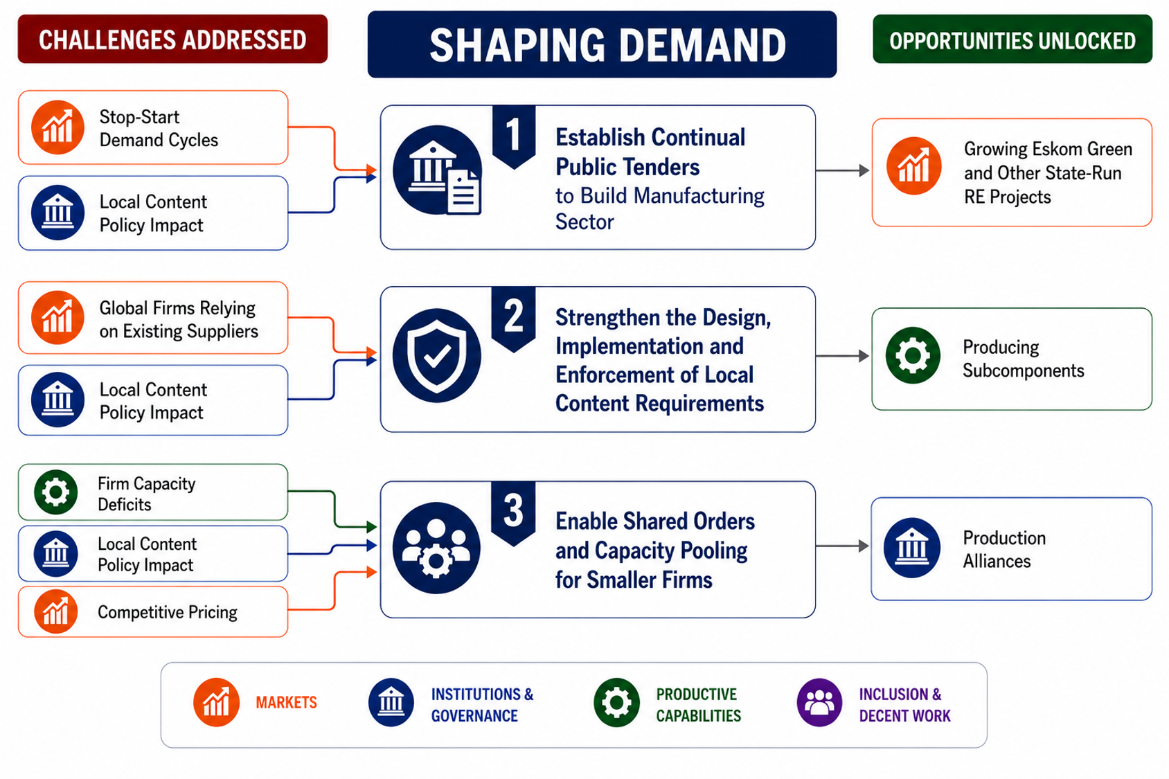
ANNEX - SHAPING DEMAND
Sourced from a Detailed Case Study from the localising the Just Energy Transition project

Slide 28
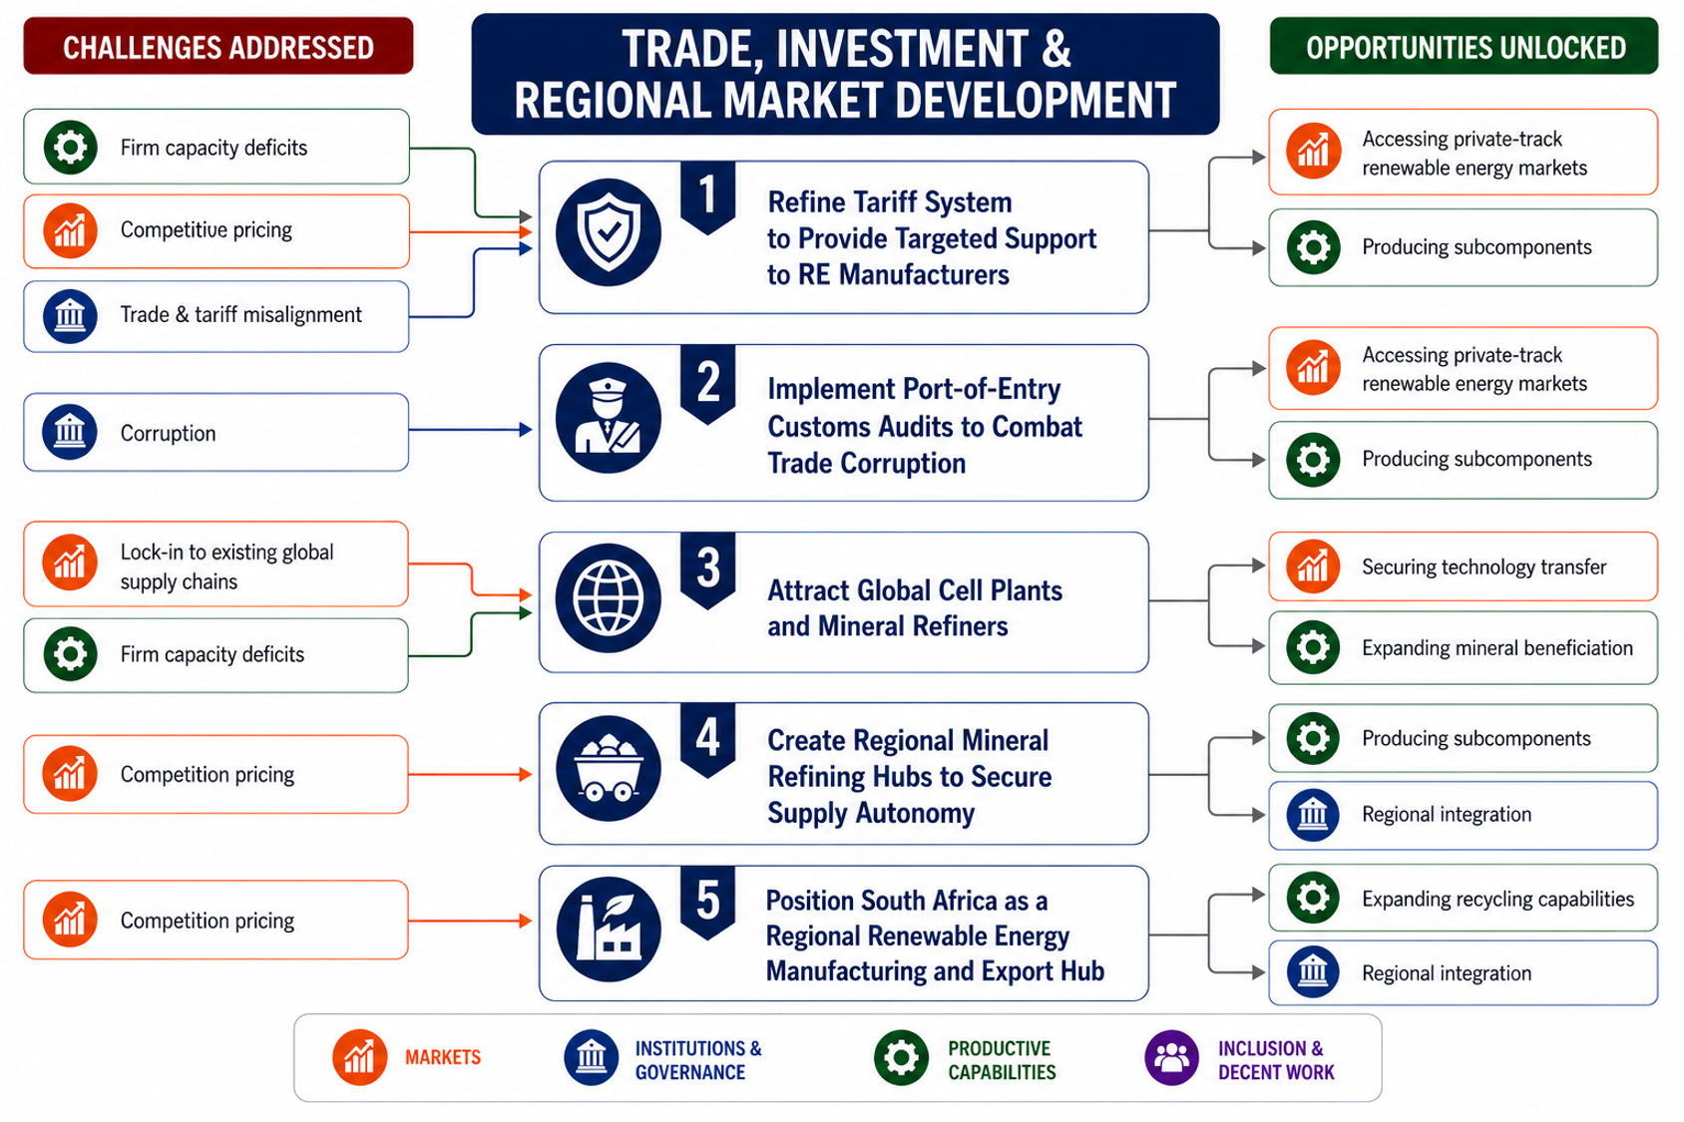
ANNEX- TRADE, INVESTMENT AND MARKET DEVELOPMENT
Sourced from a Detailed Case Study from the localising the Just Energy Transition project

Slide 29
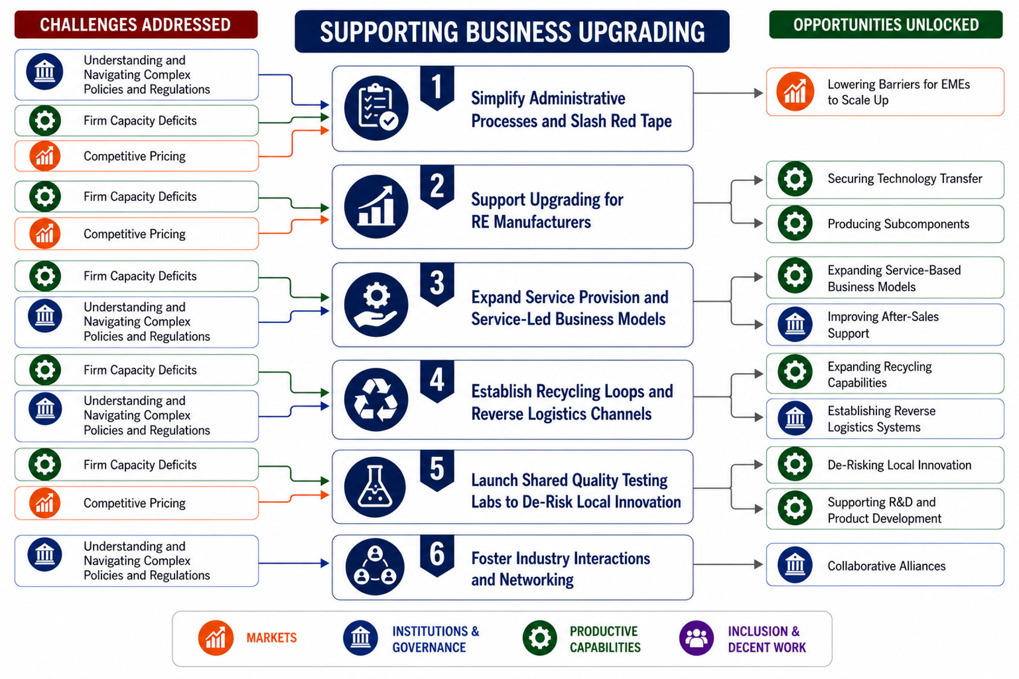
ANNEX- ENABLING ENVIRONMENT
Sourced from a Detailed Case Study from the localising the Just Energy Transition project

Slide 30
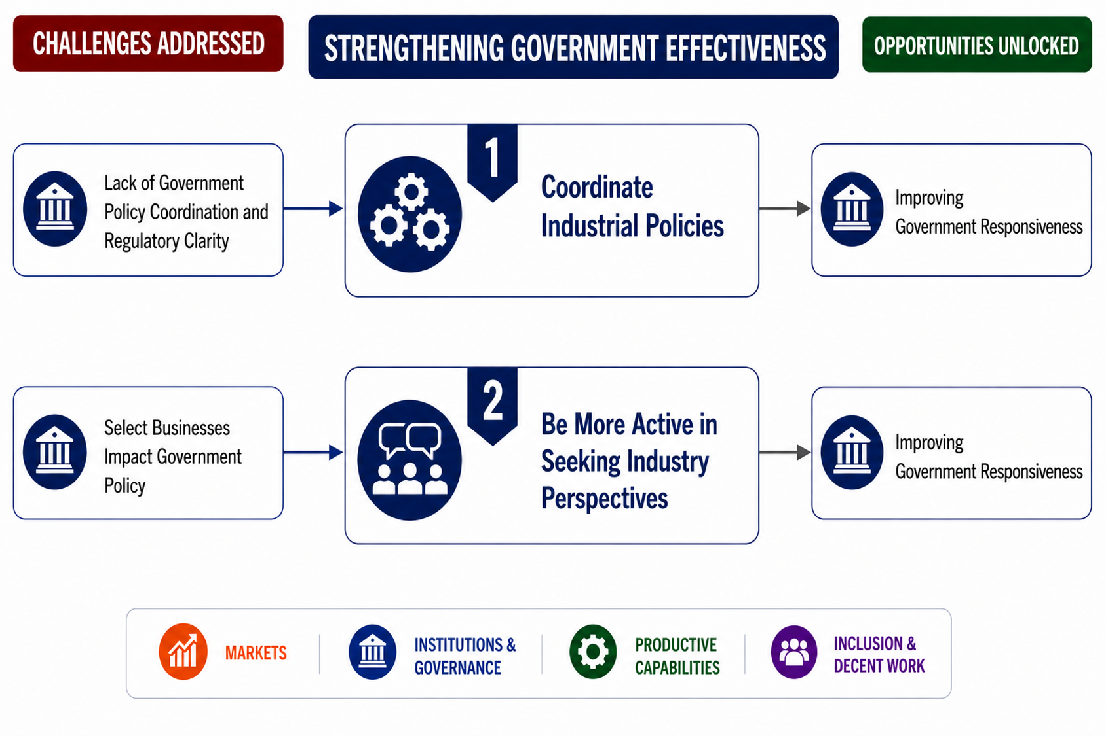
ANNEX - GOVERNMENT EFFECTIVENESS
Sourced from a Detailed Case Study from the localising the Just Energy Transition project

Slide 31
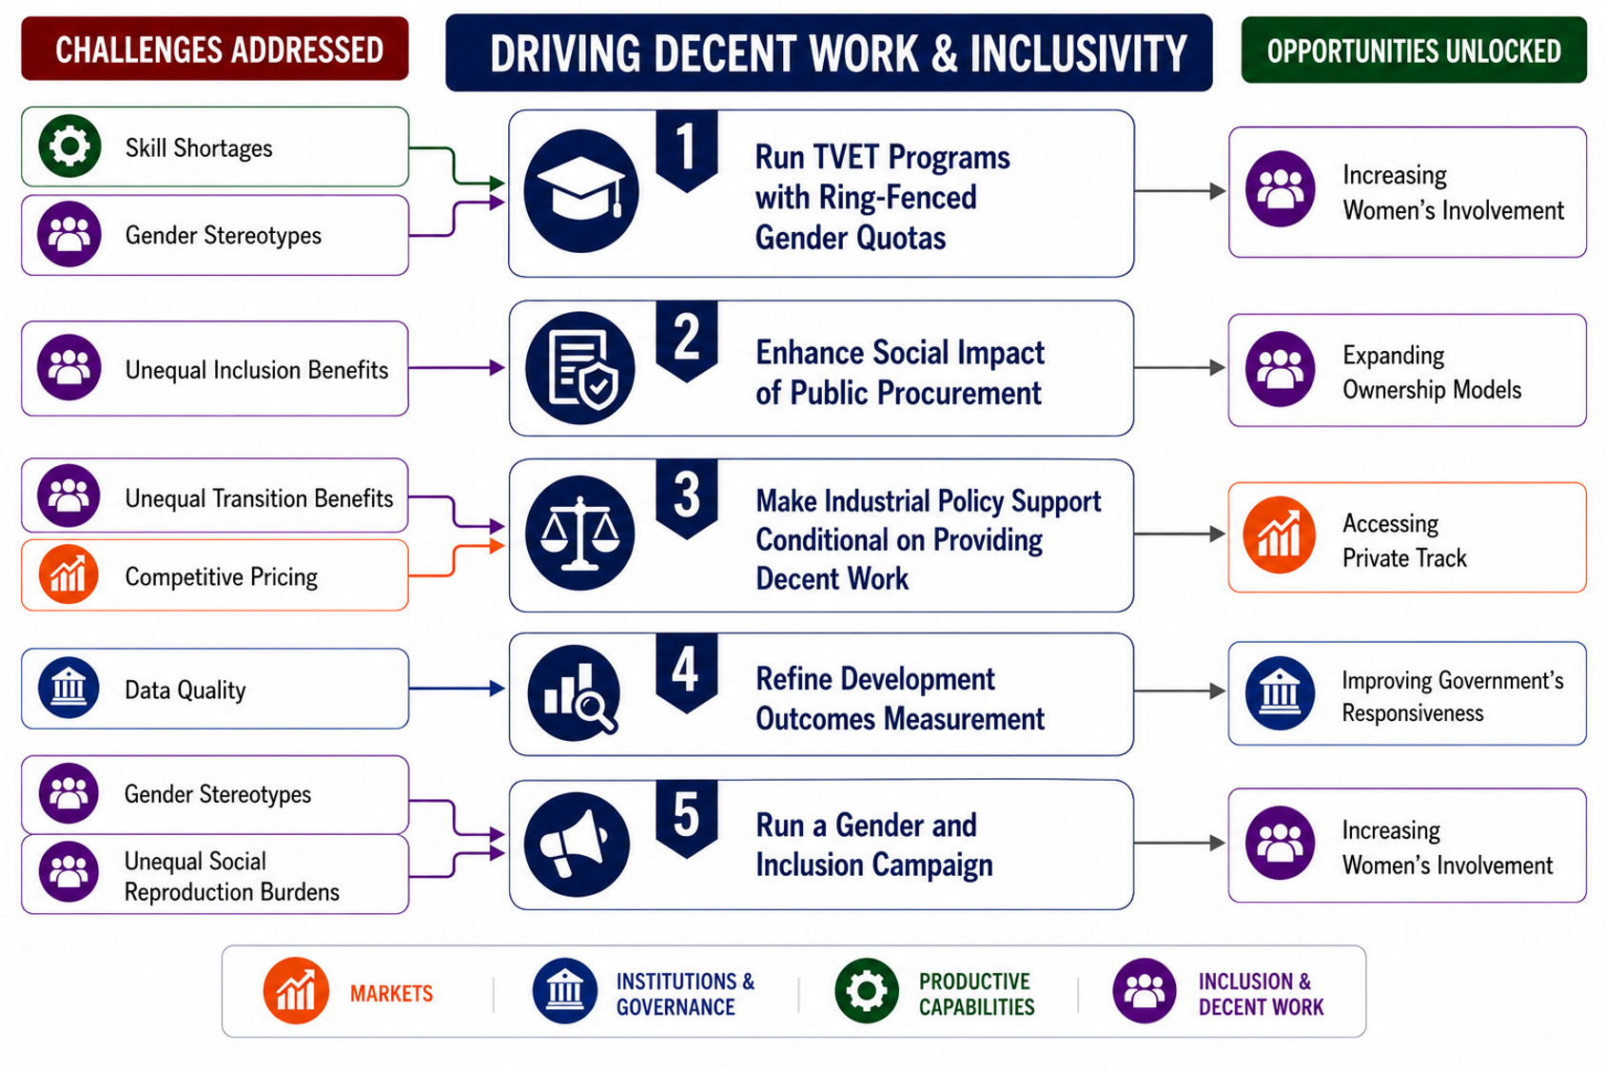
ANNEX - DRIVING DECENT WORK & INCLUSIVITY
Sourced from a Detailed Case Study from the localising the Just Energy Transition project

