Slide 1
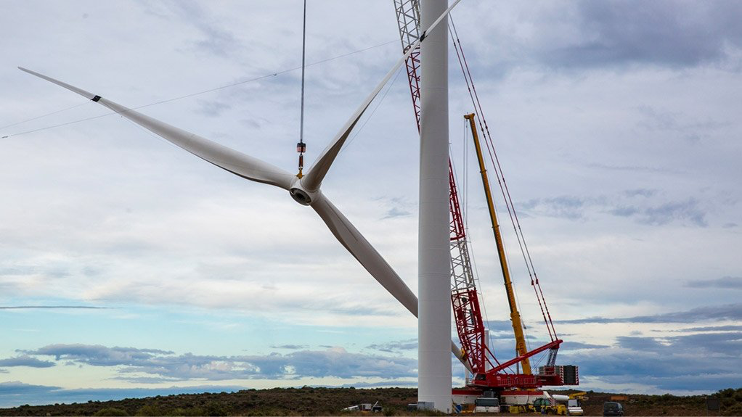
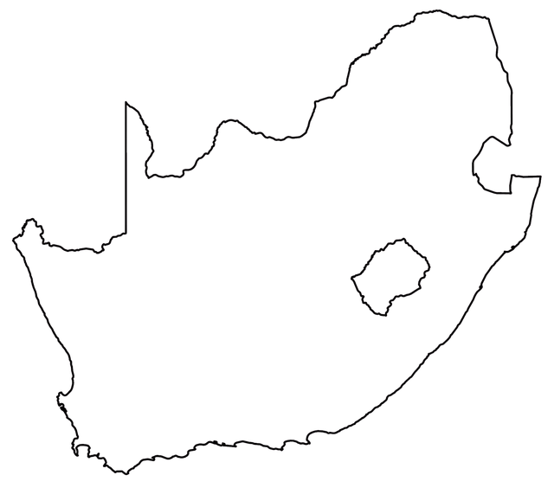

THE START
2015
INDUSTRY
850 TONS

Slide 2
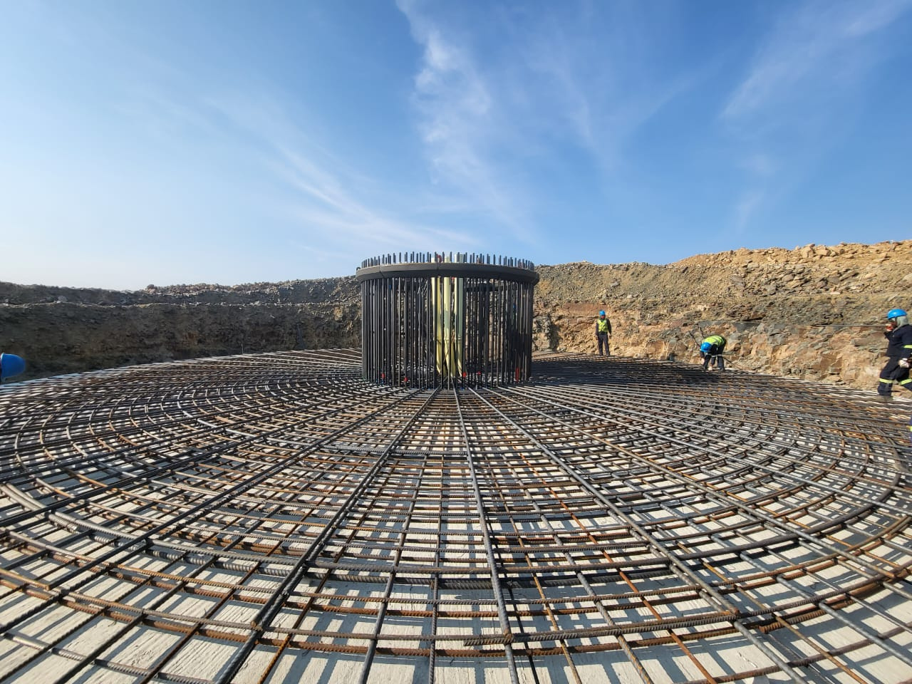
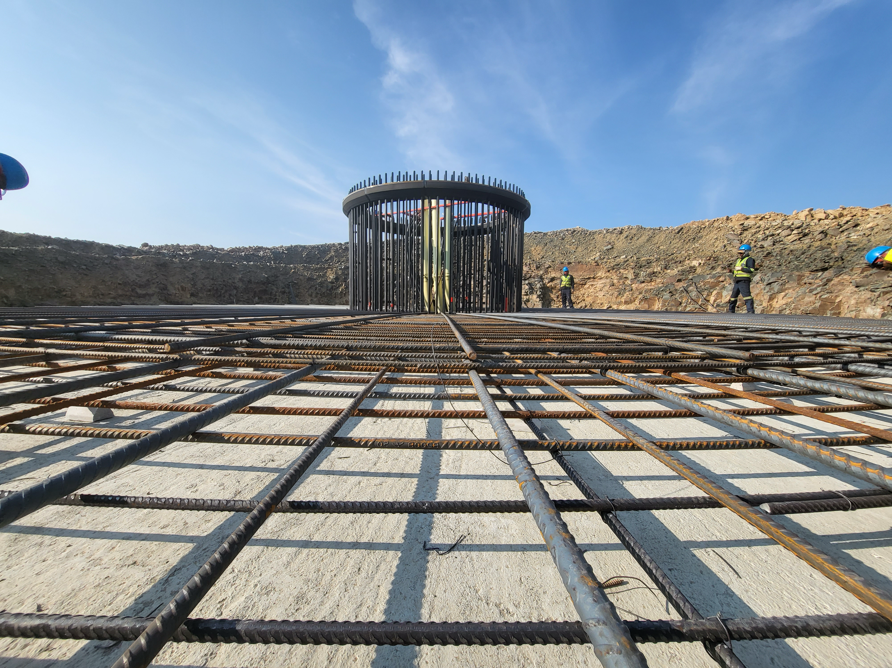
LOCAL CONTENT
2015
BW5
300 NEW JOBS
ONE ITEM

Slide 3
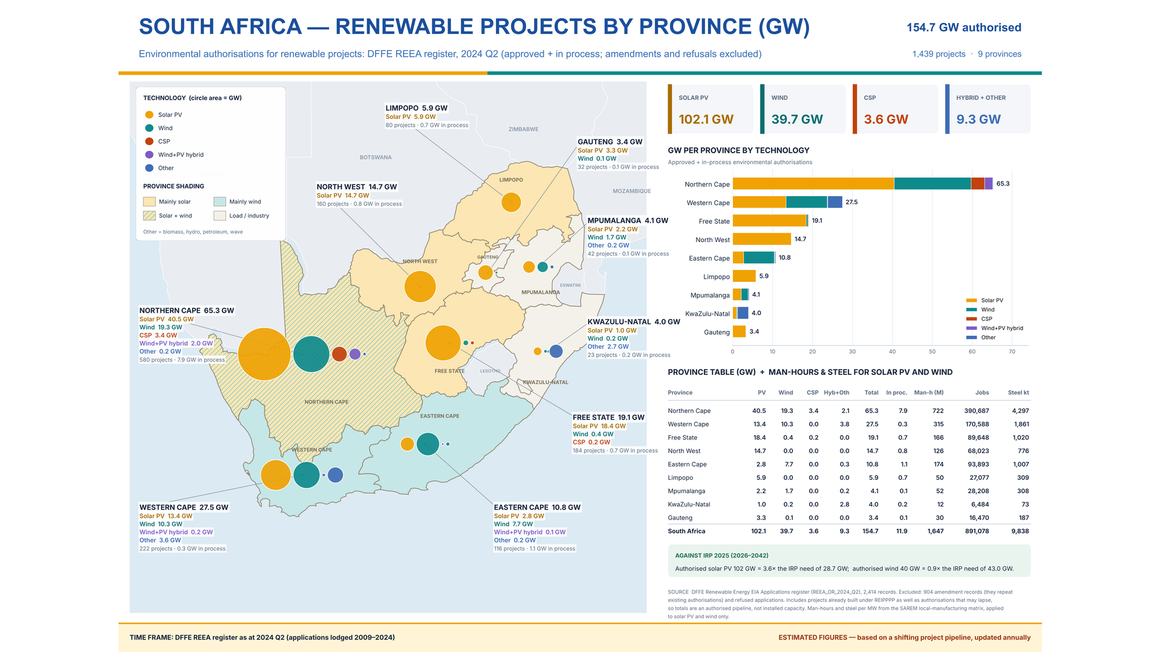

Slide 4
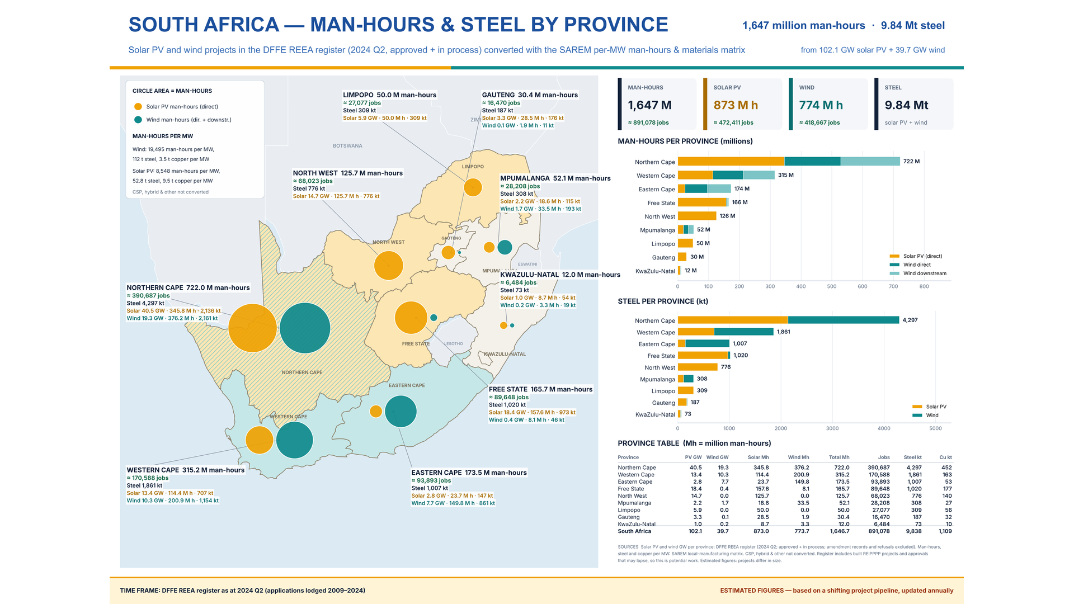

Slide 5
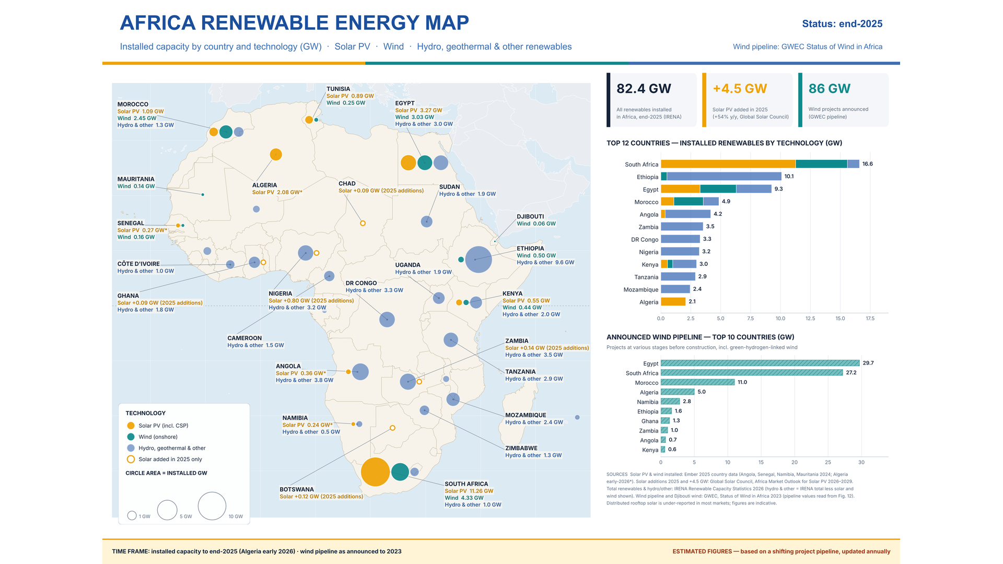

Slide 6
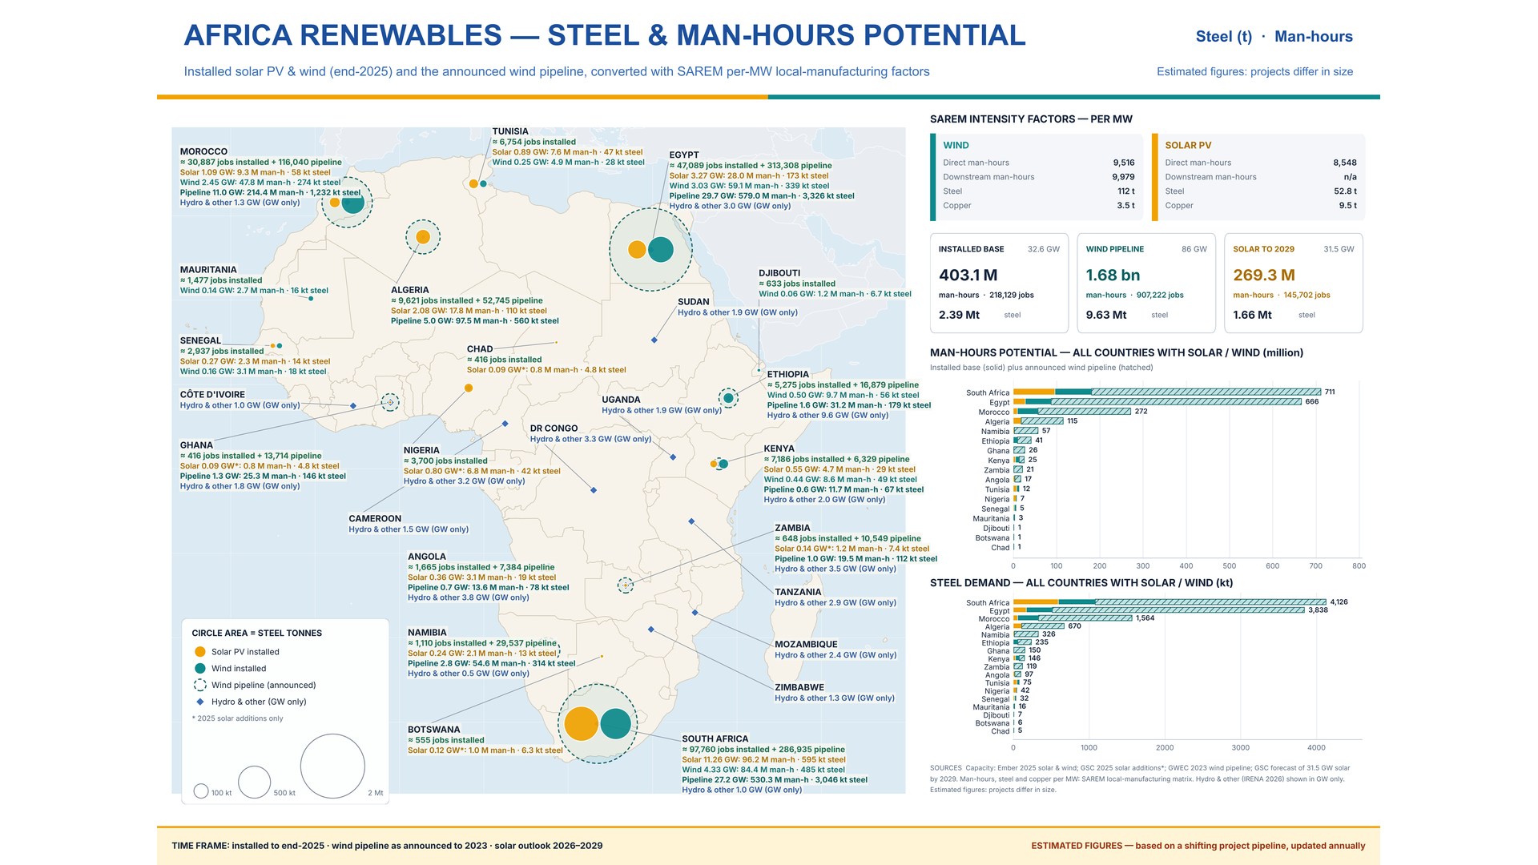

Slide 7
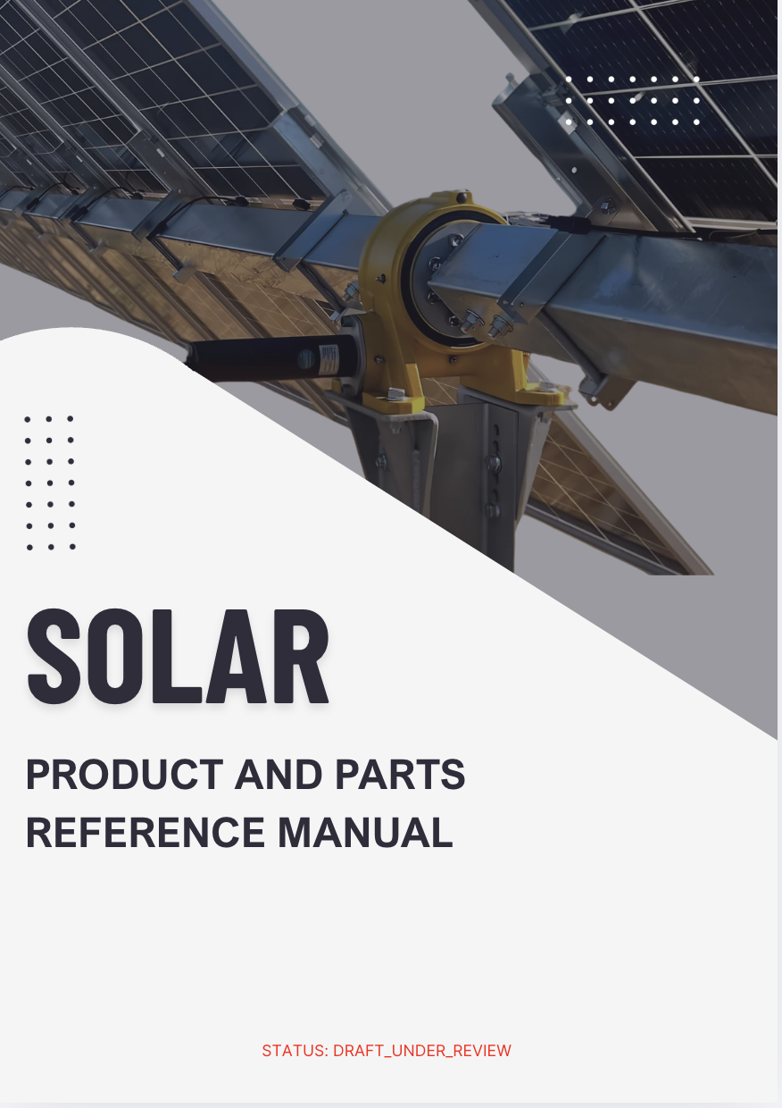
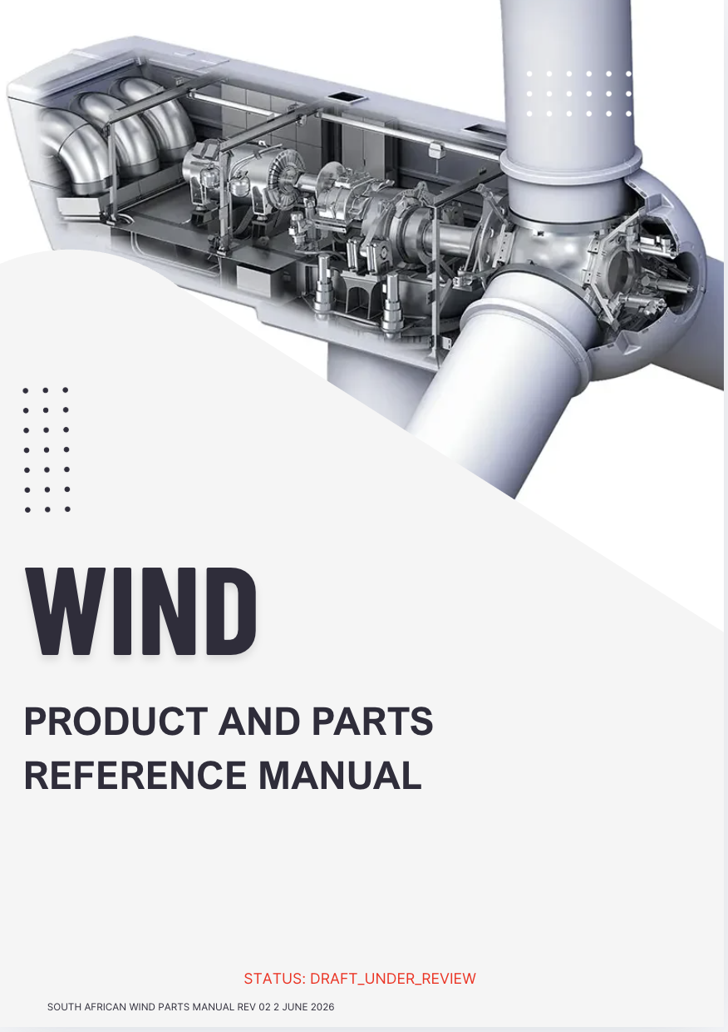


Notes:
The manual I have created to assist in the developing and understanding of part that can be manufacture in the industry

Slide 9
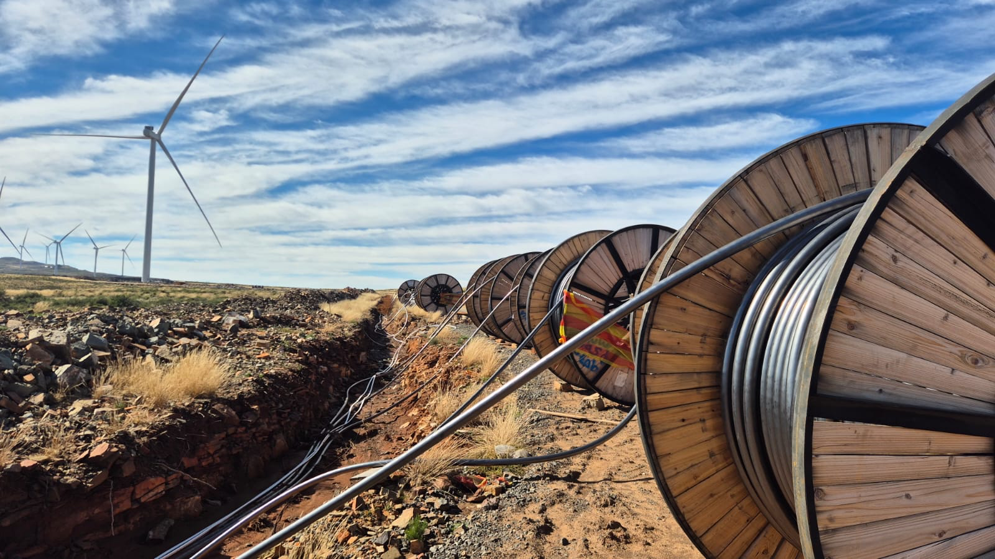
HOW POLICY
2021
UNDERMINED
THE PIPE LINE

Slide 10
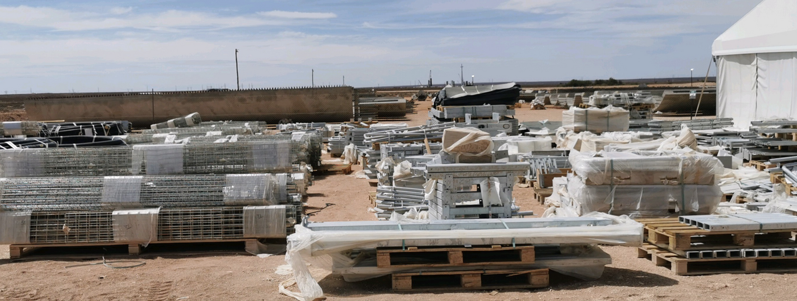

FROM MANUFATURING
Ongoing
TO 0 % DUTY
IMPORT
MANUFACTURING
IMPORT

Slide 11
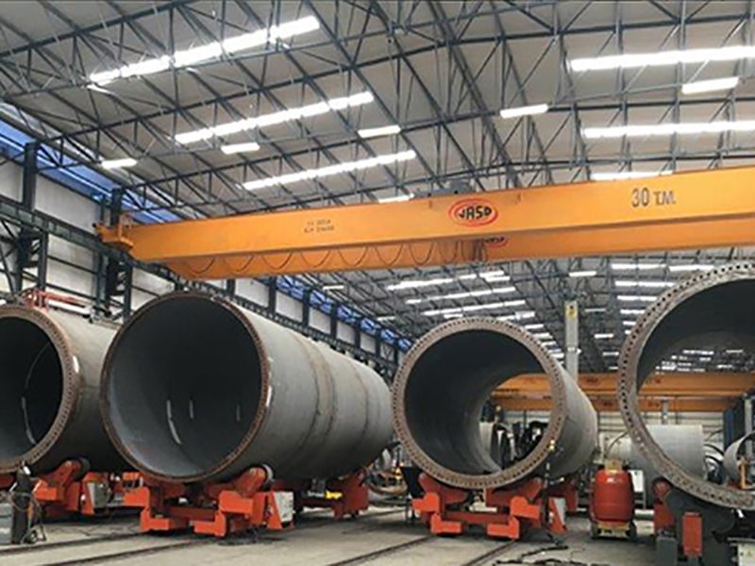
POLICY
Ongoing
SC-CF-48 SARS
0% DUTY FULL IMPORT
TURNING FULL FACTORY

Slide 12
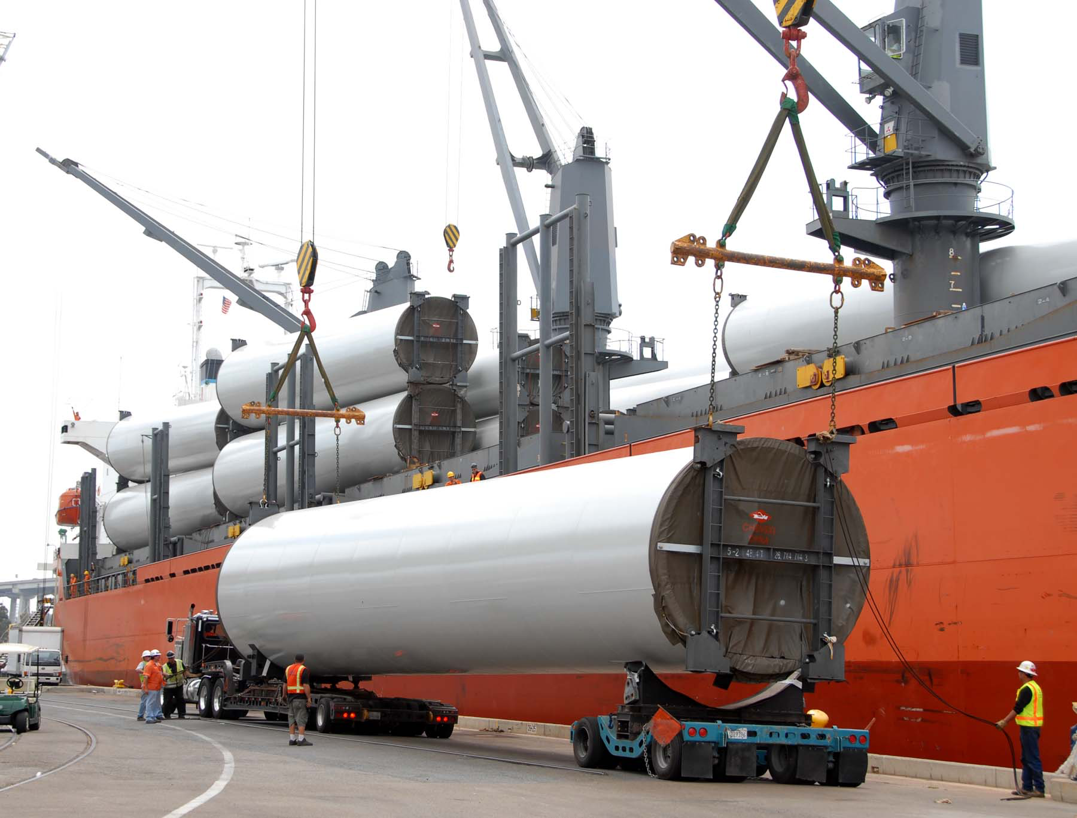
IMPORT
Ongoing
0% DUTY FULL IMPORT
TURNING JUST
INTO IN JUST

Slide 13
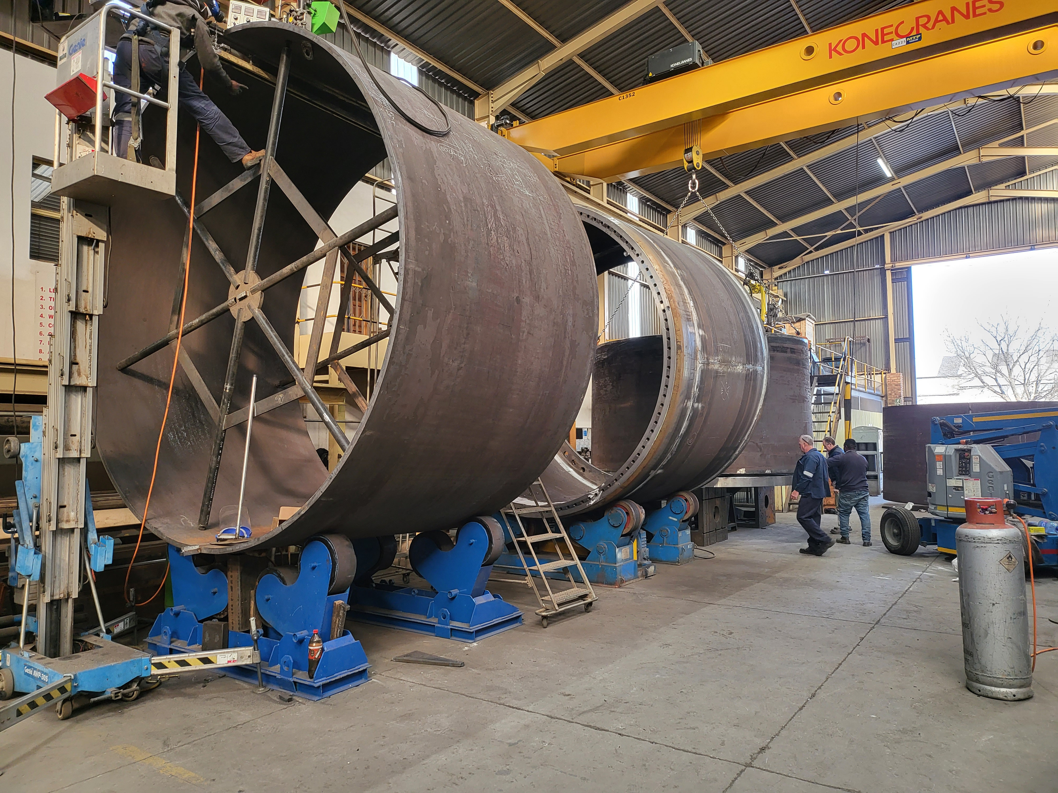




POILICY
IS IMPORTANT
USED WRONG
IS FATAL TO INDUSTRY
300 LOST JOBS
20% CAPACITY
20% CAPACITY 150 JOBS LOST
CLOSED
AND THE DOWNWARD SPIRAL DOES NOT STOP TO AN ESTIMATED 2000 JOBS LOST

Slide 14

POILICY
USED CORRECT
WILL CREATE
JUST TRANSITION

